Slide 1

UBER NEW YORK DATA ANALYSIS
By Karthik Peddavarapu

Slide 2

PROBLEM STATEMENT
Uber faces the challenge of optimizing service efficiency, identifying demand patterns, and improving the customer experience in a dynamic urban environment. By analyzing ride data, Uber can uncover key trends such as peak ride hours, active service areas, and variations in demand across different days and times. Understanding these patterns will enable Uber to enhance operational efficiency, optimize vehicle allocation, improve driver availability, and ultimately provide better service to riders. This data-driven approach is crucial for maintaining competitive advantage and delivering a seamless, on-demand ride experience to users.

Slide 3

DATASET OVERVIEW
Timeframe: January to June 2015
Rows: ~1M records
Source: Kaggle

Slide 4


DATA CLEANING & FEATURE ENGINEERING
Removed duplicate entries and null values.
Extracted Month, Weekday, Hour, Day, Minutes from Pickup_date.
Created pivot tables for visual exploration.

Slide 5
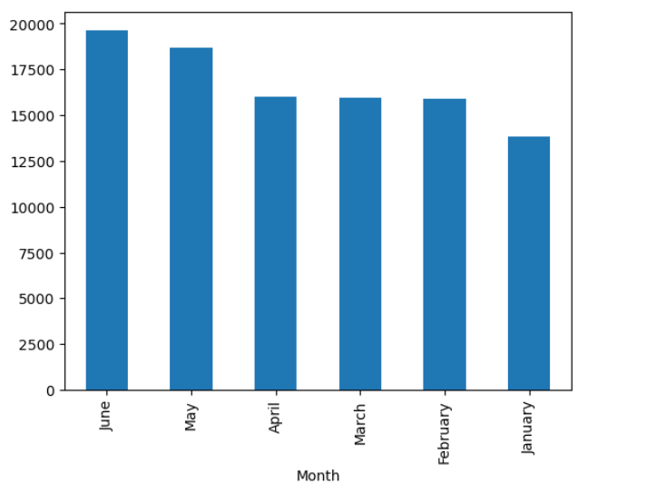
MONTHLY RIDE TRENDS & ACTIONABLE INSIGHTS
June recorded the highest ride volume – approximately 20,000 rides.
May followed closely behind, showing strong ride demand.
April, March, and February had consistent performance (~15,000 rides).
January showed the lowest activity, below 15,000 rides.
Overall trend: Steady increase in rides from January to June.

Slide 6
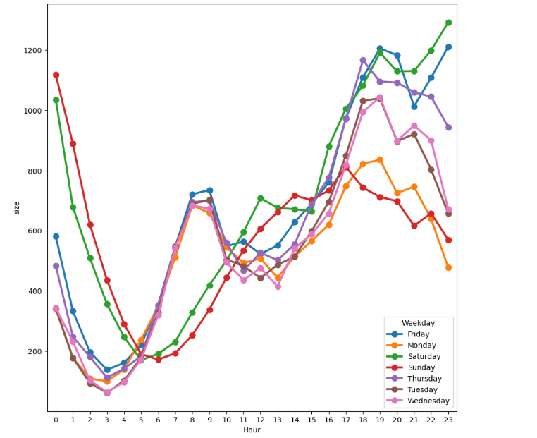
HOURLY RUSH IN NEW YORK
Peak Hours: Highest activity observed at 6:00 PM (18:00) and 9:00 PM (21:00)
Top Performing Day: Friday shows the highest overall ride activity.

Slide 7
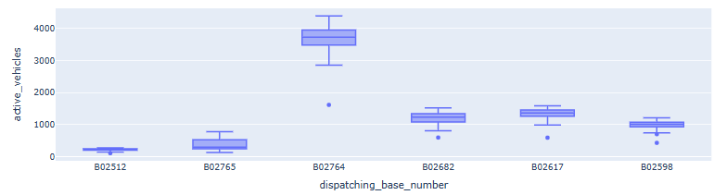
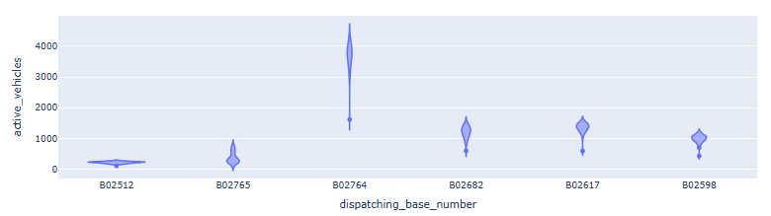
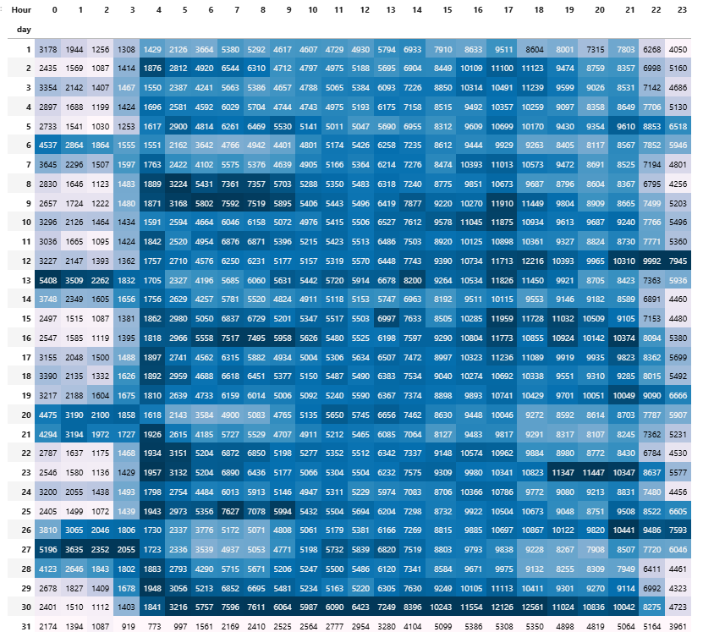
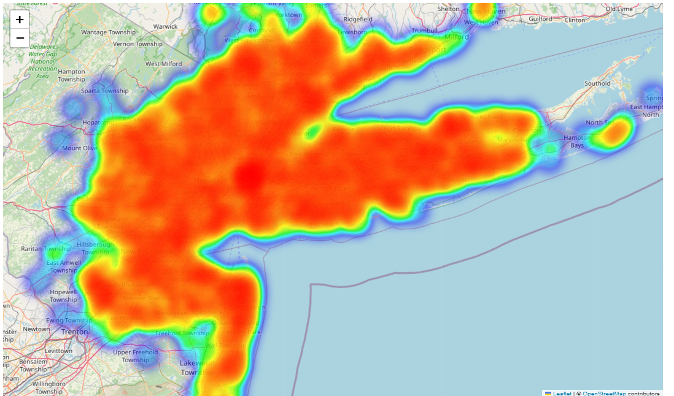
Key Visual Insights from Uber Data Analysis

Slide 8

Key Visual Insights
Busiest Months: June & May
Busiest Day: Friday
Peak Hour: 5 PM to 7 PM
Visualization tools: Matplotlib and Seaborn

Slide 9

Insights & Conclusions
High demand on weekday evenings commuter traffic.
Monthly trends show growth in Uber usage.
Visual patterns provide actionable insights to support data-driven fleet management strategies.

Slide 10

Tools & Skills Used
Tools: Python, Pandas, Seaborn, Matplotlib, Jupyter Notebook
Skills: Data Cleaning, Visualization, Insight Derivation

Slide 11

THANK YOU

